Slide 1




Project - 1
Power BI Driven Exhaustive Analysis of Indian Agriculture Sector​

Slide 2


DISCLAIMER
The content is curated from online/offline resources and used for educational purpose only.

Slide 3
About project
In this Project, 19 Years of Indian Agriculture data was taken in CSV format from 33 states, 646 districts, from all five seasons. Total of 122 unique crops were identified. Power BI based Data Analysis is implemented. Using this approach, we can unlock valuable insights and Predict Minimum Support Price of a Crop for the given Crop Year can be estimated.
Learning Objectives:
Exploratory Data Analysis on Production of different Crops Over Years
Top Crops, Seasons, States, Districts etc.
Key Performance Indicator(KPIs)
Various Metrics to get deep insights about the business
Notes:
Good [morning/afternoon], everyone. Today, I will be discussing a project that leverages 19 years of Indian agriculture data.
This data is collected in CSV format, covering 33 states and 646 districts across all five seasons.

Slide 4
Learning Objectives: ​
​
Exploratory Data Analysis on Production of different Crops Over Years​
​
Top Crops, Seasons, States, Districts etc. ​
Key Performance Indicator(KPIs)​
Various Metrics to get deep insights about the business​
Notes:
In this project, our primary learning objective is to conduct exploratory data analysis (EDA) on crop production over the years. We will identify the top crops based on production metrics while examining their performance across various seasons, states, and districts. Establishing key performance indicators (KPIs) is essential for measuring crop production efficiency, and we will analyze metrics such as yield per hectare, production costs, and market prices. By utilizing these various metrics, we aim to gain deeper insights into the agricultural business, ultimately informing better decision-making for farmers, policymakers, and stakeholders in the sector.

Slide 5
Week 1 Connect Dataset to Power Bi ​
The data for this project is based on the Indian Agriculture dataset, which can be accessed from various government sources and agricultural research organizations. Please note that the specific link may vary depending on the availability and accessibility of the dataset at the time of your access.
Link: apy_1.csv
Tools Used
Power BI refers to a business intelligence (BI) platform developed by Microsoft. It allows users to connect to various data sources, analyze it, create interactive visualizations, and share their findings with others. Power BI offers both a desktop application for detailed analysis and a cloud-based service for sharing and collaboration.
In this Project Space Mission data source is of CSV type. After Importing the data into Power BI, we will write DAX which is useful for the analysis of the data, and sorting of various columns will be done. Visualization will be implemented and formatted. Finally, the functionality of the project will be tested and submitted

Slide 6
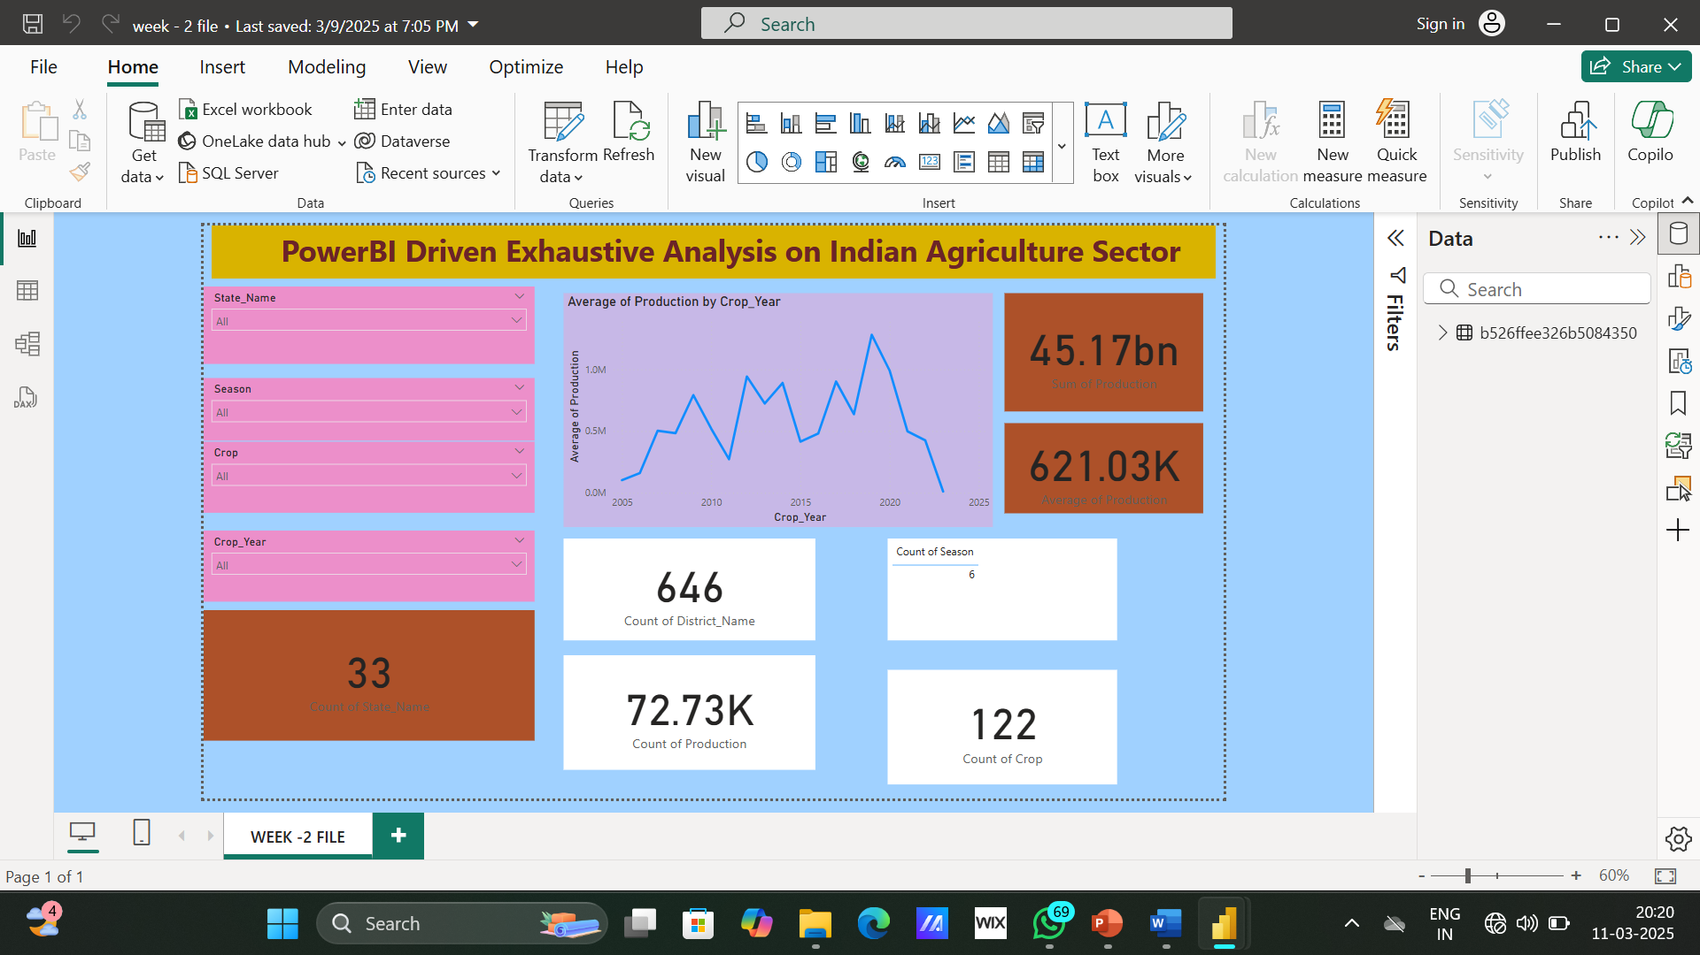
Week 2 Create Visuals in Power Bi ​

Slide 7
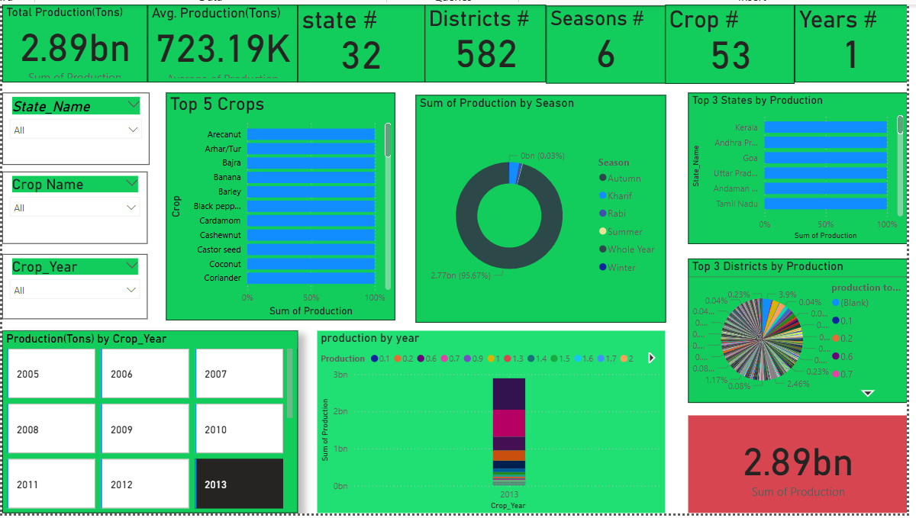
Week 3 Apply Dax to Dashboard ​

Slide 8
Future Scope
The project aims to conduct a Exhaustive analysis of the Indian agriculture sector using data analytics techniques. It will involve collecting and integrating diverse data sources, including crop production data, weather patterns, states, and districts data year wise.
The analysis will focus on identifying key trends, challenges, and opportunities in Indian agriculture, such as crop yield prediction, market price forecasting etc.
The project will predict future crop production and actionable insights to support informed decision-making by farmers, policymakers, and agribusinesses. Ultimately, the goal is to enhance productivity, sustainability, and resilience in the Indian agriculture sector through data-driven approaches.
Notes:
The project aims to conduct an exhaustive analysis of the Indian agriculture sector using data analytics techniques. This will involve collecting and integrating diverse data sources, including crop production data, weather patterns, and regional information year-wise. The analysis will focus on identifying key trends, challenges, and opportunities in Indian agriculture, such as crop yield prediction and market price forecasting. By predicting future crop production and providing actionable insights, the project will support informed decision-making for farmers, policymakers, and agribusinesses. Ultimately, the goal is to enhance productivity, sustainability, and resilience in the Indian agriculture sector through data-driven approaches.

Slide 9
Summary : ​
​
Conduct a comprehensive analysis of the Indian agriculture sector using data analytics techniques.
Collect and integrate diverse data, including crop production, weather patterns, and regional information.
Identify key trends, challenges, and opportunities.
Predict crop yields and forecast market prices.
Provide actionable insights for informed decision-making by farmers, policymakers, and agribusinesses.
Enhance productivity, sustainability, and resilience in the Indian agriculture sector through data-driven approaches.
Notes:
This project aims to conduct a comprehensive analysis of the Indian agriculture sector using advanced data analytics techniques. By collecting and integrating diverse data sources—including crop production data, weather patterns, and regional information—the project seeks to uncover key trends, challenges, and opportunities within the agricultural landscape. Key focuses include predicting crop yields and forecasting market prices, which will provide valuable insights for farmers, policymakers, and agribusinesses. The ultimate goal is to enhance productivity, sustainability, and resilience in the Indian agriculture sector through informed, data-driven decision-making.

Slide 10
References
https://community.fabric.microsoft.com/t5/Power-BI-forums/ct-p/powerbi
https://learn.microsoft.com/en-us/power-bi/create-reports/sample-sales-and-marketing
https://powerbi.microsoft.com/en-us/customer-showcase/
https://www.mavenanalytics.io/data-playground?page=4&pageSize=5
https://learn.microsoft.com/en-us/training/modules/get-data-power-bi/

Slide 11
Conclusion
The Power BI-driven analysis of the Indian agriculture sector provides valuable insights into the trends, patterns, and challenges faced by the industry. By leveraging 19 years of historical data, the project has successfully identified key crops, regions, and seasons that contribute significantly to the overall production. The analysis has also revealed regional disparities, the impact of climate factors, and the potential for growth through diversification and improved agricultural practices.
The interactive dashboard developed in Power BI empowers users to explore and visualize the data in a user-friendly manner, enabling informed decision-making and policy development. The findings from this analysis can be utilized by policymakers, researchers, and agricultural stakeholders to address the challenges faced by the sector and promote sustainable and equitable agricultural development in India.

Slide 12
Thank You
Notes:
Thank You !!

